Slide 1
Online INVESTIGATION
Ravindranath Patil

Slide 2
Contents
The Problem Statement
Exploring Solutions
What is Online Investigation?
Case Studies
Challenges during Investigation
Brain Teasers

Slide 3

The Problem Statement
An interplay between technology and law

Slide 4

The Problem Statement

Slide 5
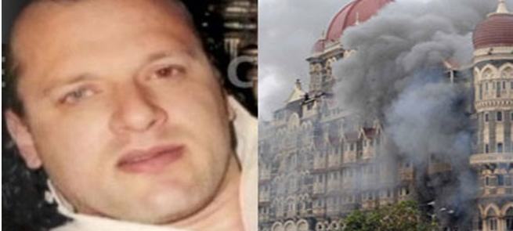
Future Calling
Case Studies of David Coleman Headley and 26/11 Investigations

Slide 6
Investigation of 26/11 Mumbai Terror Attack
Taj
Hostage nos
Western Union
money transfer
Internet Telephony Known As VOIP
Oberoi
Hostage nos
+12012531824 VOIP
VOXBONE
Belgium
ILD
Gateway
Nariman House
Hostage nos

Slide 7
Investigation of 26/11 Mumbai Terror Attack
Testimony of Kasab:
  All the 10 terrorists were equipped with a Nokia 1200 phone and a SIM Card each, which were provided by the Pakistani Handlers (i.e. total ten mobiles and ten SIM cards)
Findings during investigation:
  Five of the 10 mobile phones recovered from Scene of Crime:
    Two in Oberoy – one with original SIM, one lady victim’s SIM
    One in Taj
    One in Nariman House (Gabrian’s SIM) and
    One unused Mobile: Recovered during searches at Oberoi.
Evidence :
  Testimony of Nokia India Rep from Gurgaon – none of the IMEI sold in India
  Testimony of legal rep of Nokia China (Donga) – two of the five IMEI sold in Pakistan
  Cross examination over Video Conferencing
  Record of interceptions of four IMEI, along with testimony of ATS PI, Mr. N. T. Kadam

Slide 8
Investigation of 26/11 Mumbai Terror Attack
Testimony of Kasab:
  Terrorists were asked to call on the VIOP no +12012531824 as well as to long-press the green button on Nokia 1200 to speed-dial.
Findings during investigation:
  Gateway interception of calls from four IMEI & Multiple SIMs to the VOIP;
  The VOIP Service Provider, Voxbone Approached;
  The KYC Details were obtained;
  Money Trail was identified towards obtaining of connection.
Evidence :
  CDRs of 17 Nos: Confirmed that Internet Calls made during the 26/11 period;
  KYC Records of Voxbone: Fake subscriber Khadak Singh, India; Passport submitted along with belonged to Pakistan;
  Money Gram Fund Transfers to Voxbone, New Jersey were traced to Pakistan;
  Testimony of Abu Jundal: He, along with Vasi and Qafa attended calls from Karachi.

Slide 9
Investigation of 26/11 Mumbai Terror Attack
Challenges:
  Location of VOIP Calls: It could not be proven basis technical evidence that the handlers of terrorists were receiving VIOP calls made from Taj, Oberoi and Nariman House from a location/ Cell Site in Pakistan, as VOXBONE doesn’t maintain any logs without a prior notice by LEAs. (IMPACT: Locational Data of VOIP calls during similar investigations)
  FBI Intervention: The KYC documents from VOXBONE as well as the evidence of Money Trail could not be obtained BUT FOR the effective intervention by the FBI, as the handlers of terrorists had made payment to the New Jersey office of VOXBONE.
  Cost of foreign visits: The Mumbai police officers had to conduct visit to New Jearsey to obtain the documents. (May happen once in million cases in an Indian police department!)
  Compatibility with 65B: The Nokia China Legal Rep sent an email to Nokia’s India office regarding the connection of Nokia 1200 phones with Pakistan, which was produced before the court. (Pseudo- 65 B Certificate and its compatibility in the wake of Anwar Basheer Case?)
  Voice matching: Voice samples of the handlers in Pakistan are yet to be made available.

Slide 10
Case Study of David Coleman Headley
On September 13, 2009 amid reports of Ilyas Kashmiri’s death in a drone attack, HEADLEY spoke to his contact in Pakistan.
During the conversation, he was using code-words such as “doctor” and “peersaab” for Ilyas Kashmiri.
This 13 minute phone call, according to FBI ended at 5.09 pm Chicago time
And at 5.12 pm HEADLEY did a Google search for “Ilyas Kashmiri “ to read the latest reports.
He repeated his search 3 days later on September 16, 2009 at 7.29 pm.
On October 3, 2009 HEADLEY was off to Chicago O’hare international airport on way to Pakistan, when FBI nabbed him.

Slide 11
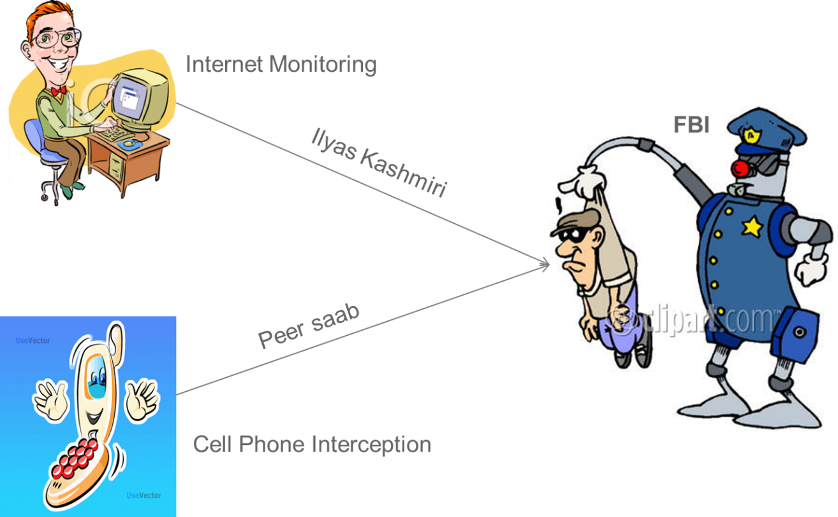
Case Study of David Coleman Headley

Slide 12
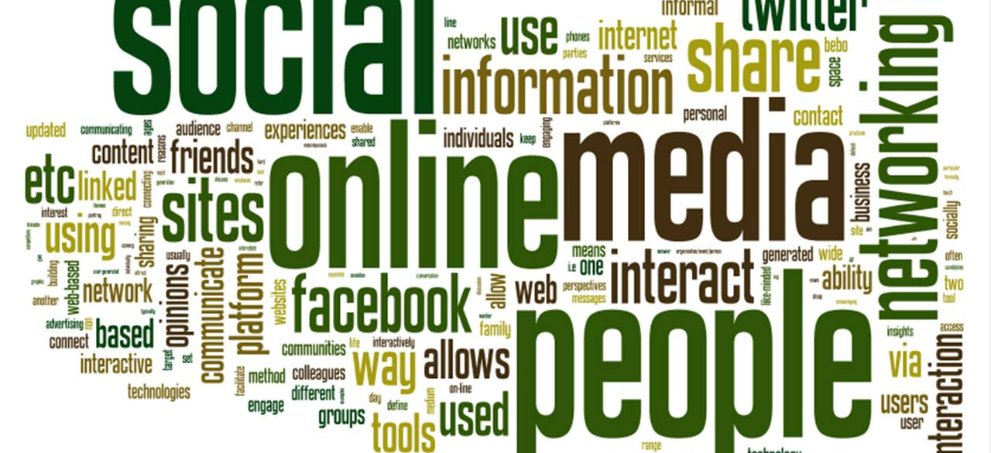
What is Online Investigation?
Peeping into visible and invisible webs

Slide 13
What is Online Investigation?
Information

Slide 14
What is Online Investigation?
Internet

Slide 15
What is Online Investigation?
Visible Web
Content freely accessible across the internet and indexed by search engines
Internet
Invisible Web
Content behind paywalls and private databases that cannot be indexed by search engines

Slide 16
What is Online Investigation?
Media / History
Financial Details
Financial Details
Media / History
Visible Web
Content freely accessible across the internet and indexed by search engines
Invisible Web
Content behind paywalls and private databases that cannot be indexed by search engines
Socio-Political Details
Socio-Political Details
International Presence
Litigation and Regulatory Issues
Litigation and Regulatory Issues
International Presence

Slide 17
Objectives of Online Investigation
Proactive:
  Surveillance on anti-social elements
  Law and order management
  Riot Control
  Gathering intelligence

Slide 18
Objectives of Online Investigation
Reactive:
  Criminal Investigations
    Computer as a target: Data Theft, Hacking, Breach of Confidentiality
    Computer as a tool: Criminal Conspiracy, Cyber Terrorism, Pornography, Identity Theft, Phishing Attacks, Cyber Defamation, Enmity amongst religions, Cheating and Forgery, other Bodily offences
  Law & Order Management:
    Riot Control
    Rumour Containment
  Civil Matters:
    Evidence in dispute cases

Slide 19



Means of Online Investigation

Slide 20
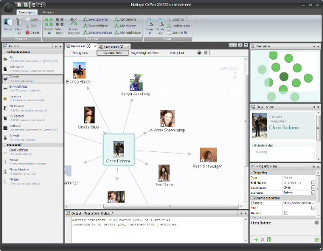
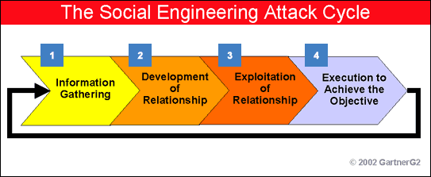
Means of Online Investigation

Slide 21
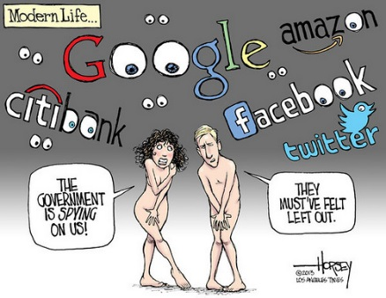
The End Result?

Slide 22
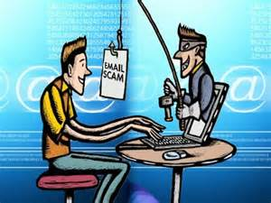
Case Studies
Our experience of online investigations

Slide 23
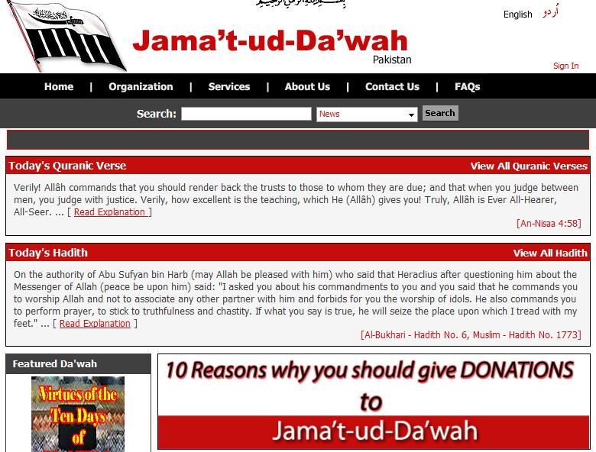
Fundraising by LeT (2008)

Slide 24
Jihadi Website: Maulana Shabbir (2008)
  www.h_alali.net
  www.aloqla.com
  www.rubee.net
  www.dweesh.com
  www.khayma.com
  www.jaafaridris.com
  www.naseh.net
  www.alsalafyoon.com
  www.awkaf.net
  www.alsalfiyat.com
  www.islamweb.net
  www.resalah.net

Slide 25
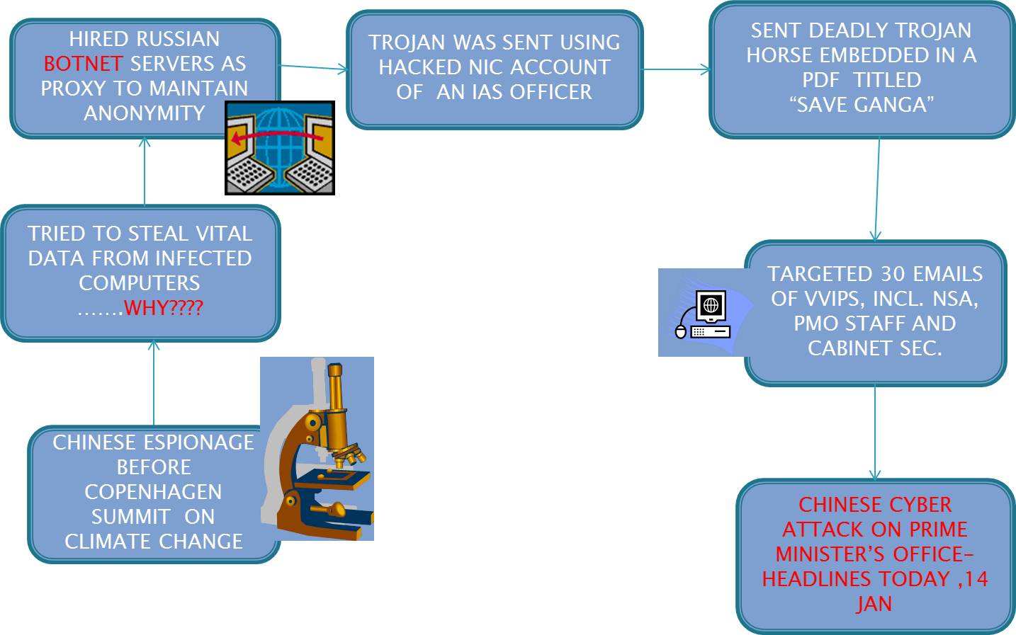
Cyber Attack on PMO (2009-10)

Slide 26
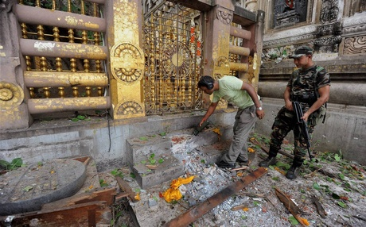
Bodh Gaya Blasts (2013)

Slide 27
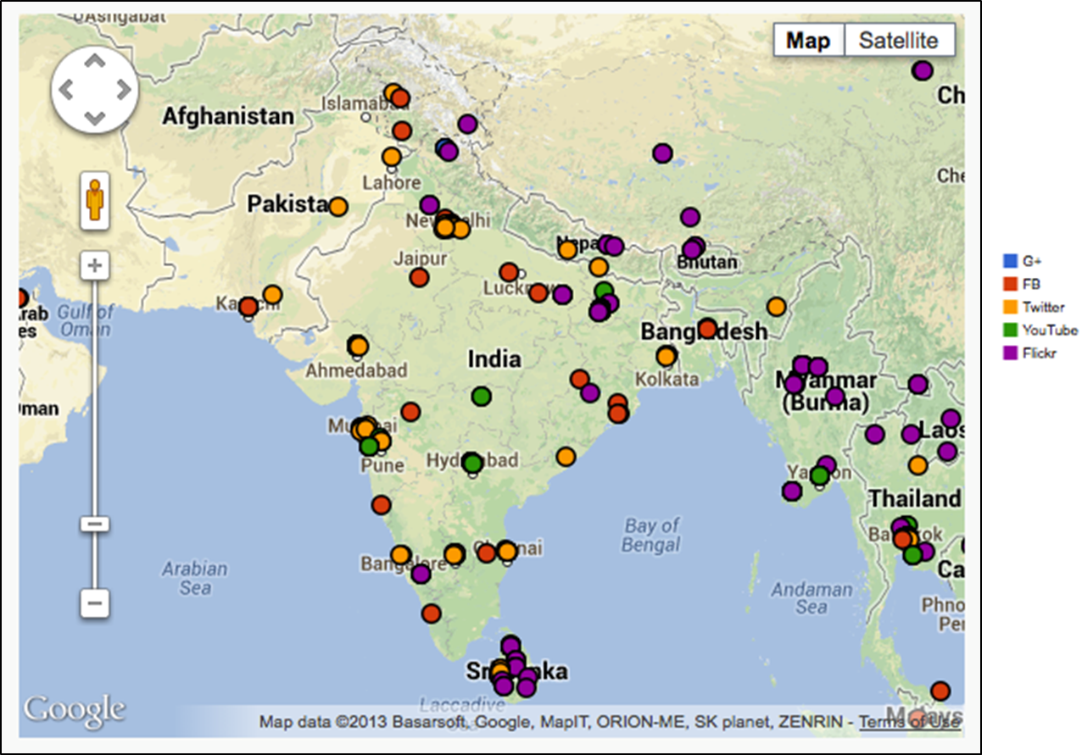
Bodh Gaya Blasts (2013)
Keyword | bodhgaya | bodh gaya | mahabodhi | Total Posts | Unique users
Facebook | 7,341 | 2,849 | 2,319 | 8,609 | 7,021
Twitter | 3,134 | 5,151 | 532 | 8,510 | 4,099
YouTube | 214 | 325 | 247 | 576 | 135
Google+ | 98 | 160 | 124 | 303 | 163

Slide 28
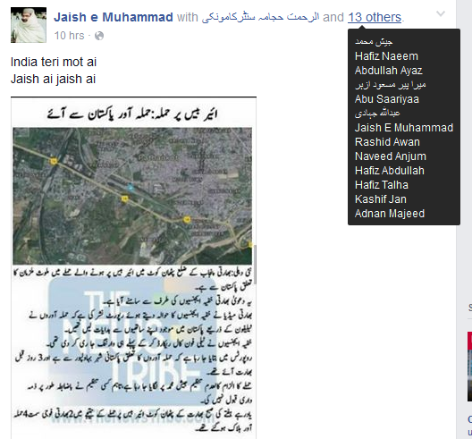
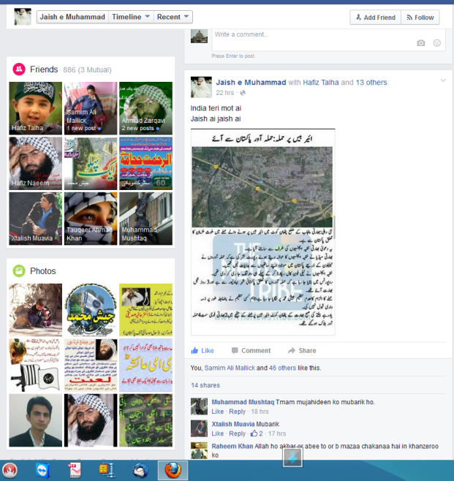
Pathankot Attack
On 2 Jan 2016 at 11.53 AM, a message was posted on the FB page of Jaish-e-Muhammad regarding Pathankot attack.
Thirteen people were tagged in it, one of which turned out to be an Indian, who is potentially operating from Pakistan.

Slide 29

Challenges during Investigation
Legal, procedural and technological challenges

Slide 30
Challenges during investigations
Legal Challenges
Trans-national crimes (Jurisdiction?)
Regulatory Challenges
Maintenance of electronic records by service providers
Standards of data preservation (Period/ process etc)
Technological Challenges
Network forensics
Technology change and changing forensic practices
Legal viability of investigative procedures
Data stored on internet clouds
Complexity 65 B
Immunity of middlemen u/s 78 IT Act
Complexity of MLAT & Letter Rogatory
Proxy servers and email spoofing

Slide 31
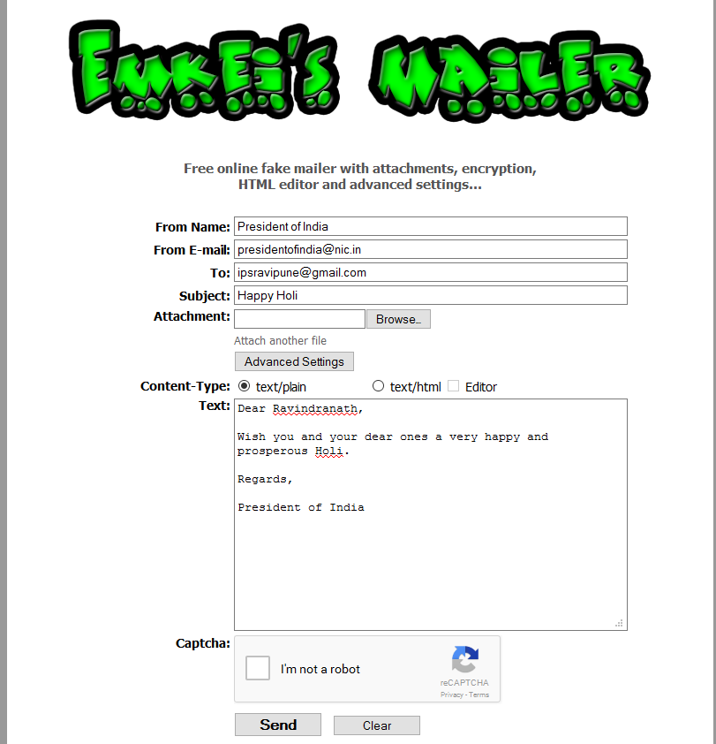
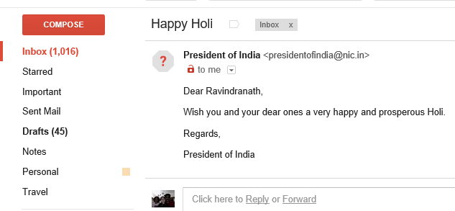
Challenges: Email Spoofing

Slide 32

Brain Teasers
Widen your horizons

Slide 33
Brain Teasers
A threat email has been sent to a national media and the IP address has been traced to a Wireless Access Point;
A criminal has been arrested and during custodial interrogations, he has shared his email id and password;
A CCTV Footage needs to be seized in connection with an investigation, along with relevant documentation;
A Facebook profile reflects adversely during an investigation. However, the Facebook authorities have refused to cooperate;
  During an investigation, mail server data of a multinational company needs to be seized. The company maintains its centralized email server in Hong Kong;
  A fake bank website has been identified as part of the investigation; however the domain details are not available on account of privacy protection;
  A computer system strategic to national security. It has been attacked; however can’t be shut down and taken to FSL as it needs to be up and running 24/7.

